Slide 1

Mike Goffin and Wesley Shields
2014-11-14
Approved for Public Release; Distribution Unlimited. Case Number 14-3467

Slide 2

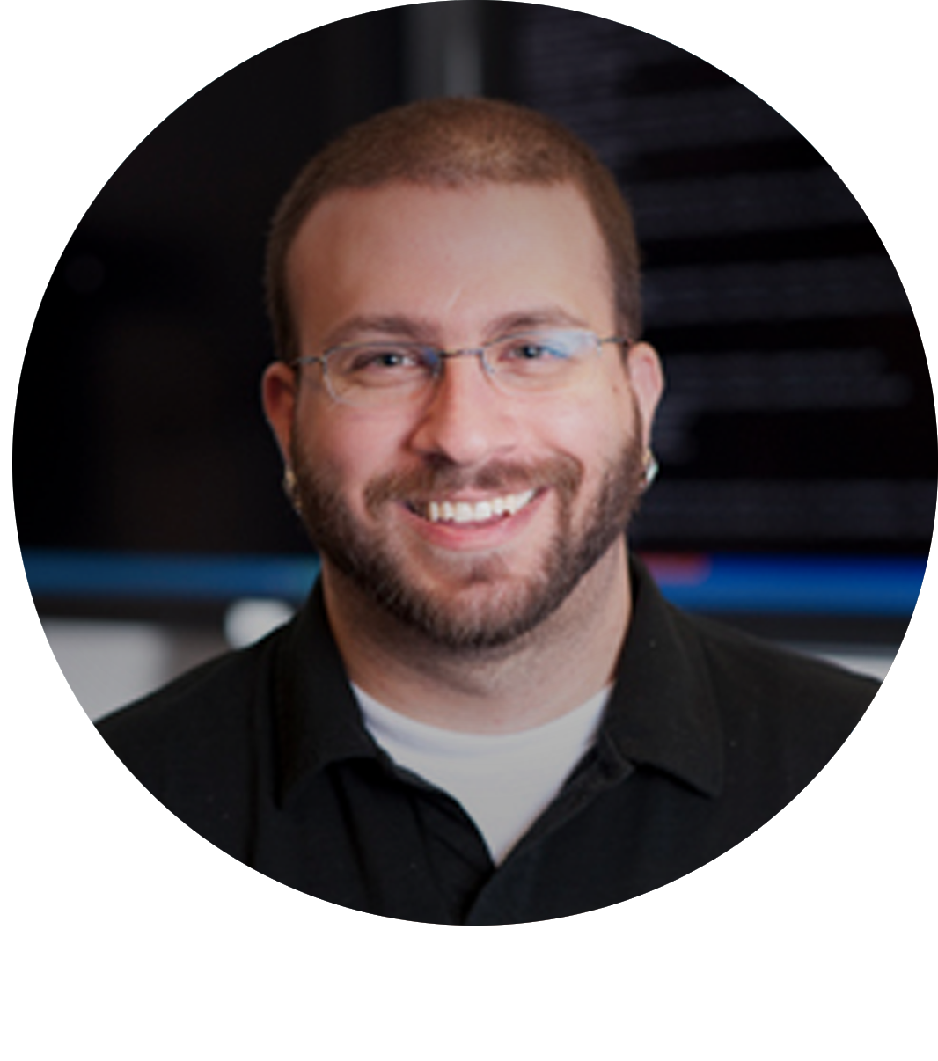
Who are we?
Mike Goffin
Wesley Shields
Project Manager
Lead Developer
Core Developer
Senior Cyber Security Research Engineer
The MITRE Corporation
Lead Cyber Security Research Engineer
The MITRE Corporation

Slide 3


Intelligence Rubber Banding
Intelligence we know.
A big problem:
As we increase actionable Intelligence, threats are incentivized to change.
The problem area:
Intelligence we don’t know.
Rubber Banding
Notes:
As we try to put the pieces of a puzzle together to get the big picture of a threat, the threat changes the puzzle and you have to start over (snap back). The goal is to improve how quickly you can stretch your rubber band and catch back up.

Slide 4
Components of Threat Data
Capability and Intent
Actionable Intelligence
Refined data ready for building into Intelligence.
Vetted and actionable Artifacts.
Artifacts
Intelligence
Unrefined data that requires processing.
Raw Data
Actionable Artifacts
Notes:
Not all Artifacts are equal even if they come out of good Raw Data. As you start to vet Artifacts and synthesize Intelligence to describe capability and intent, you can feed that Intelligence back into the cycle. Tactics vs Strategy. Artifacts = Day to day Tactics. Intelligence = overall Strategy.

Slide 5
Sources of Threat Data
External
“Automated” Internal
Human Internal
Feeds
White papers
Articles
Websites
Forums
Sharing communities
Communication mediums
Scanners
Sensors
Logs
Detonation chambers
PCAP stores
Homegrown
Reverse Engineering
Scripts
Command line/GUI tools
Manual review
Word-of-mouth

Slide 6
How do we aggregate, refine, correlate, vet, and disseminate all of this data?

Slide 7
What is CRITs?
Malware and threat data repository.
Flexible platform for combining threat data from all of your sources into one place.
Services framework to integrate with other tools.
Pivot and search to make sense of seemingly disparate data.
Collaborative analyst environment to enhance your security posture.

Slide 8




Core Technologies

Slide 9
Use Cases
CRITs as a Raw Data warehouse of potentially useful data.
Refine Raw Data into Artifacts.
CRITs as an Artifact warehouse.
Vet Artifacts and define Actionable Intelligence.
CRITs as an Intelligence warehouse.
Authoritative source for internal security posture.
CRITs as a process output aggregation point.
One place to acquire automated process output.

Slide 10
Supported Top-level Objects (TLOs)
3.1.0 Release
Campaigns
Certificates
Domains
Emails
Events
Indicators
IPs
PCAPs
Raw Data
Samples
Targets
Master
Actors
Upcoming
Disassembly Files

Slide 11
Notable Features
Sources
Comments
Favorites
Grouping
Bucket Lists
Notifications
Relationships
Objects
Screenshots
Sectors
Campaign attribution
Subscriptions
Services

Slide 12
Services Framework
Enhance capabilities using third-party tools.
Add results to CRITs automatically.
Visualize data in new ways.
Interact with other systems in real-time.
Make CRITs a part of your existing processes/procedures.

Slide 13
Demo

Slide 14
Closing Remarks
Use the right tool(s) for the job.
Tools do not replace analysts, they enable them.
People and Tradecraft are what make the difference.
Share what you can, and share often.

Slide 15
To Learn More
https://crits.github.io

Slide 16
Thanks!
Questions

Slide 17
Thanks!
'The author's affiliation with The MITRE Corporation is provided for identification purposes only, and is not intended to convey or imply MITRE's concurrence with, or support for, the positions, opinions or viewpoints expressed by the author'

